Slide 1

Overfiting and Solutions
Notes:
‹#›

Slide 2
Objectives
What is overfitting?
Why does overfitting occur?
How can you detect overfitting?
How can you prevent overfitting?
Implementation
Overfiting and Solutions
‹#›

Slide 3
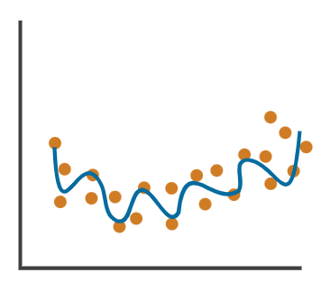
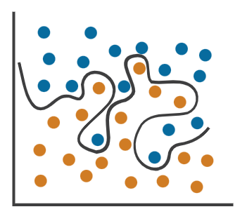
What is Overfitting
Overfitting is an undesirable machine learning behavior that occurs when the machine learning model gives accurate predictions for training data but not for new data
An overfit model can give inaccurate predictions and cannot perform well for all types of new data.
Overfiting and Solutions
‹#›
Notes:
‹#›

Slide 4
Why does overfitting occur?
The training data size is too small and does not contain enough data samples to accurately represent all possible input data values.
The training data contains large amounts of irrelevant information, called noisy data.
The model trains for too long on a single sample set of data.
The model complexity is high, so it learns the noise within the training data.
Overfiting and Solutions
‹#›
Notes:
‹#›

Slide 5
How can you detect overfitting?
The best method to detect overfit models is by testing the machine learning models on more data
K-fold cross-validation: divide the training set into K equally sized subsets or sample sets called folds. The training process consists of a series of iterations. During each iteration, the steps are:
Keep one subset as the validation data and train the machine learning model on the remaining K-1 subsets.
Observe how the model performs on the validation sample.
Score model performance based on output data quality.
Overfiting and Solutions
‹#›
Notes:
‹#›

Slide 6
How can you prevent overfitting?
Early stopping: pauses the training phase before the machine learning model learns the noise in the data.
Pruning: identify several features or parameters that impact the final prediction when you build a model.
Regularization: a collection of training/optimization techniques that seek to reduce overfitting. These methods try to eliminate those factors that do not impact the prediction outcomes by grading features based on importance.
Overfiting and Solutions
‹#›
Notes:
‹#›

Slide 7
How can you prevent overfitting?
Ensembling: combines predictions from several separate machine learning algorithms. Some models are called weak learners because their results are often inaccurate. Ensemble methods combine all the weak learners to get more accurate results. They use multiple models to analyze sample data and pick the most accurate outcomes.
Data augmentation: a machine learning technique that changes the sample data slightly every time the model processes it.
Overfiting and Solutions
‹#›
Notes:
‹#›

Slide 8
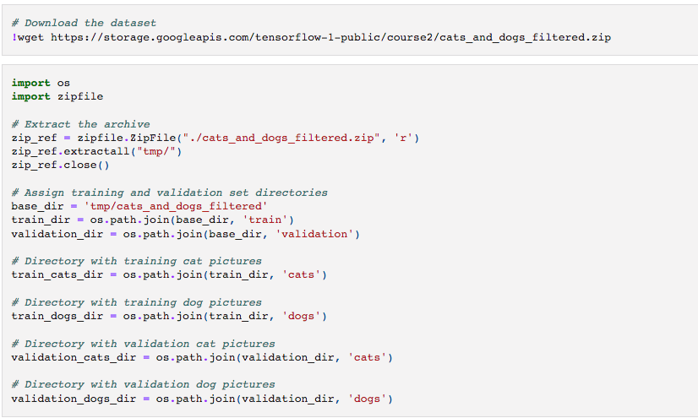
Implementation
Overfiting and Solutions
‹#›
Notes:
‹#›

Slide 9
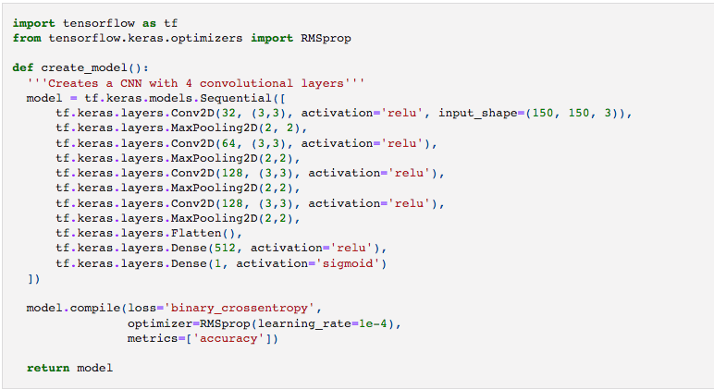
Implementation
Overfiting and Solutions
‹#›
Notes:
‹#›

Slide 10
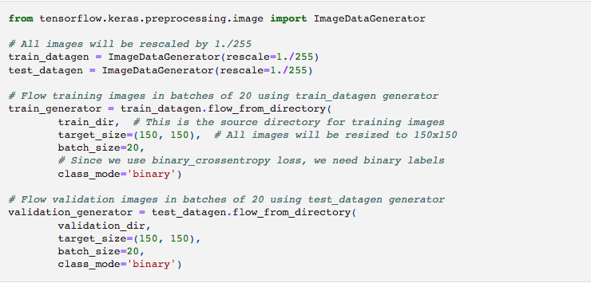
Implementation
Overfiting and Solutions
‹#›
Notes:
‹#›

Slide 11
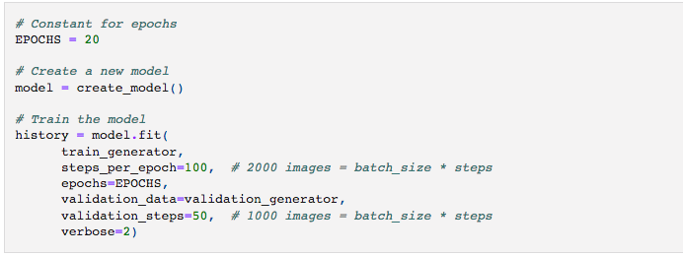
Implementation
Discuss: Students discuss what is the difference between batch size and steps per epoch?
Overfiting and Solutions
‹#›
Notes:
‹#›

Slide 12
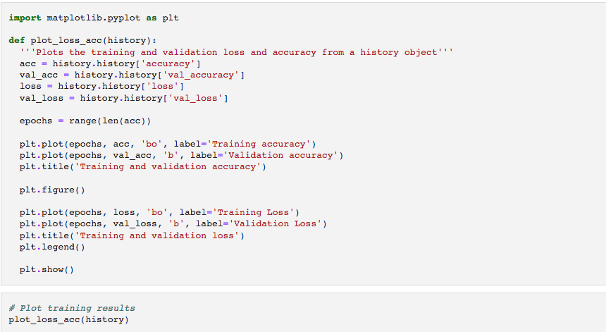
Implementation
Overfiting and Solutions
‹#›
Notes:
‹#›

Slide 13
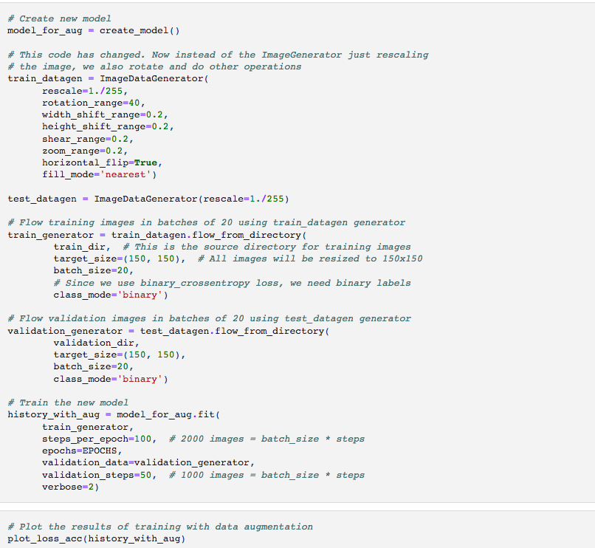
Implementation
Overfiting and Solutions
‹#›
Notes:
‹#›

Slide 14
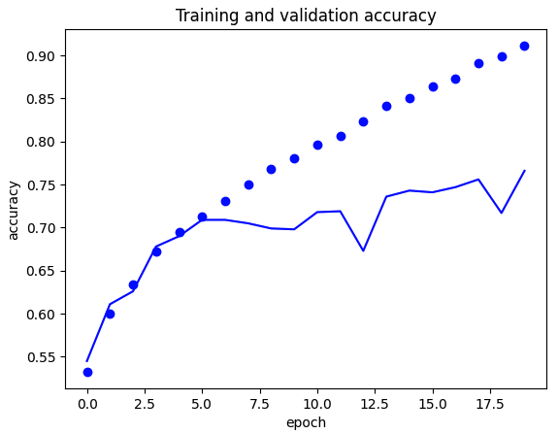
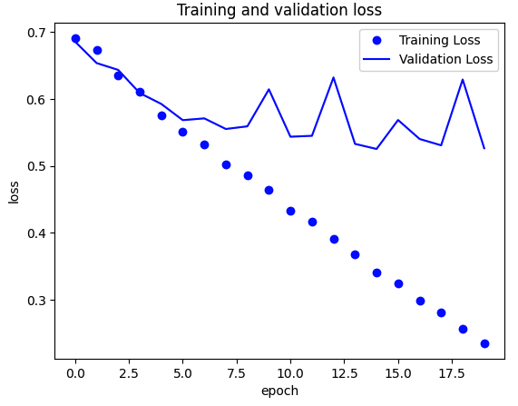

Implementation
Overfiting and Solutions
‹#›
Notes:
‹#›

Slide 15
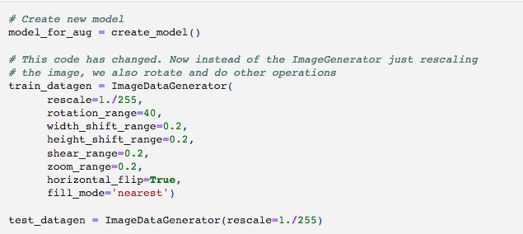
Using data augmentation
Overfiting and Solutions
‹#›
Notes:
‹#›

Slide 16
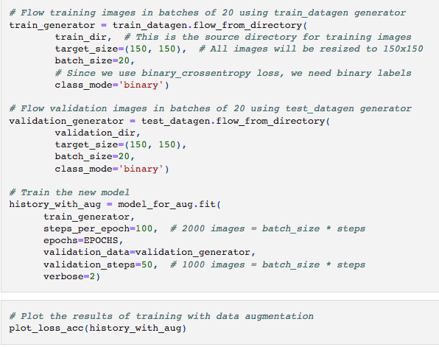
Using data augmentation
Overfiting and Solutions
‹#›
Notes:
‹#›

Slide 17
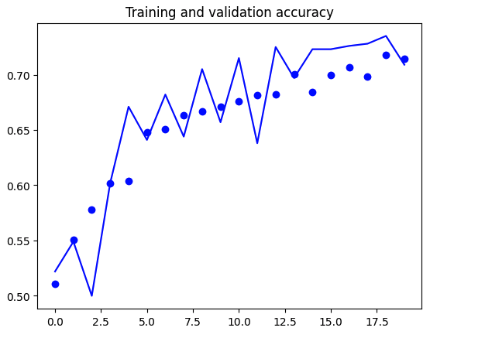
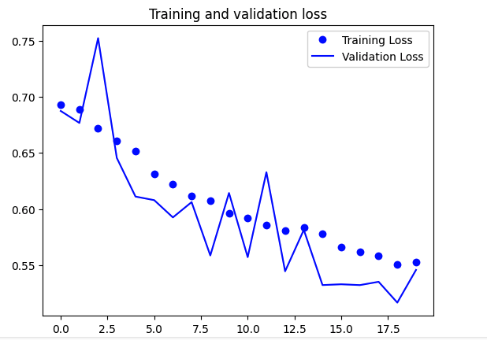



Using data augmentation
Student task: compare two models: without and with data augmentation.
Overfiting and Solutions
‹#›
Notes:
‹#›

Slide 18
batch_size & steps_per_epoch
These parameters are related to how the training data is processed during each training epoch.
batch_size:
It represents the number of samples processed in one iteration.
During training, the entire dataset is divided into batches, and each batch is processed one at a time.
The model's weights are updated after processing each batch.
Smaller batch sizes are generally used for stochastic gradient descent (SGD), while larger batch sizes are used for batch gradient descent.
Smaller batch sizes can introduce noise in the weight updates but may converge faster, while larger batch sizes may have a smoother convergence but require more memory.
Overfiting and Solutions
‹#›
Notes:
‹#›

Slide 19
batch_size & steps_per_epoch
These parameters are related to how the training data is processed during each training epoch.
steps_per_epoch:
It represents the number of batches to process before moving on to the next epoch.
This parameter is useful when you have a large dataset, and you want to specify how many batches should be processed before considering one epoch complete.
If not specified, the default behavior is to go through the entire dataset in one epoch.
Overfiting and Solutions
‹#›
Notes:
‹#›

Slide 20
Summary
What is overfitting?
Why does overfitting occur?
How can you detect overfitting?
How can you prevent overfitting?
Examples
Overfiting and Solutions
‹#›

Slide 21
Q & A
Overfiting and Solutions
‹#›

